Slide 1
Introduction to SPUFI and QMF
DB2 Training class 03

Slide 2
Difference Between SPUFI & QMF
SPUFI
QMF
We can execute multiple queries at a time.
SPUFI is just a quick and dirty SQL execution engine
Requires i/o datasets
You know the SQL-code after executing the query.
We can execute single query at a time.
QMF is a query/reporting environment with the ability to format reports.
QMF avoids allocating I/O Datasets to prevent from memory wastage.
You can't know the SQL-code of the query

Slide 3
SPUFI
SQL PROCESSING USING FILE INPUT

Slide 4
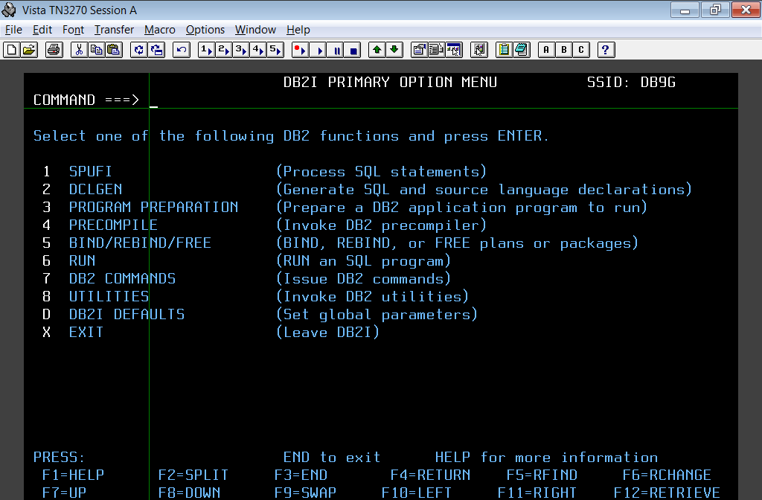

Slide 5
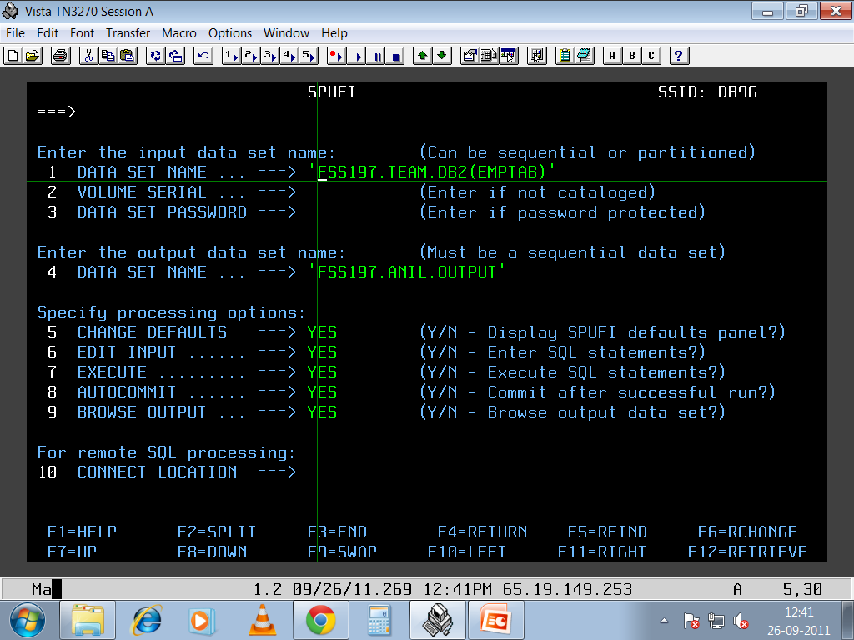

Slide 6
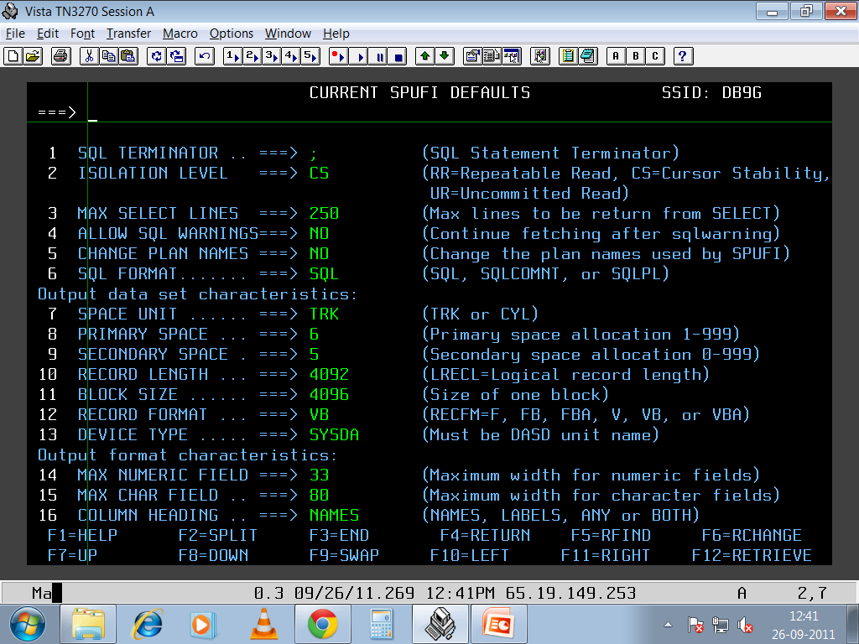

Slide 7
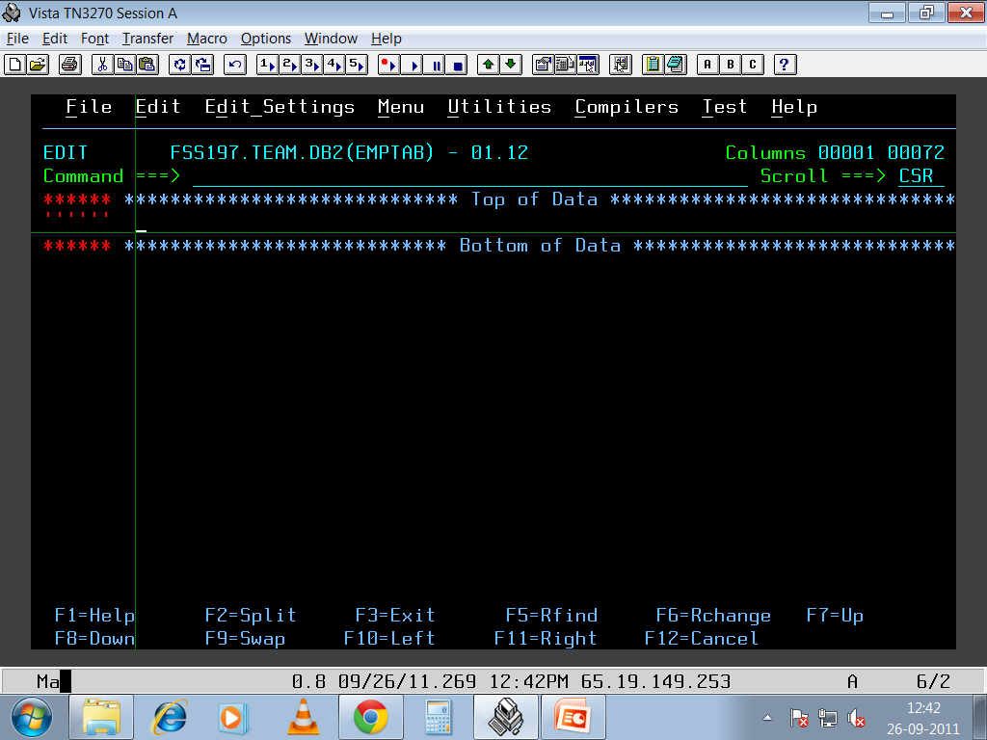

Slide 8
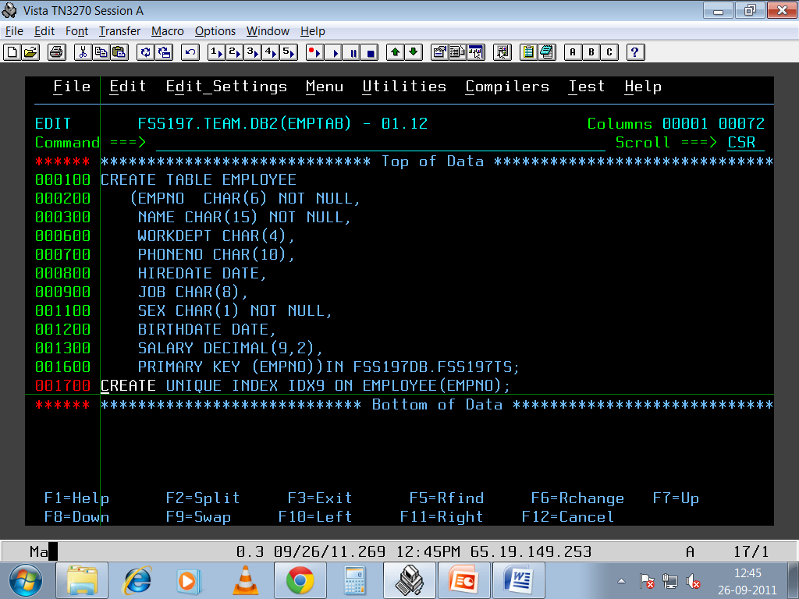

Slide 9
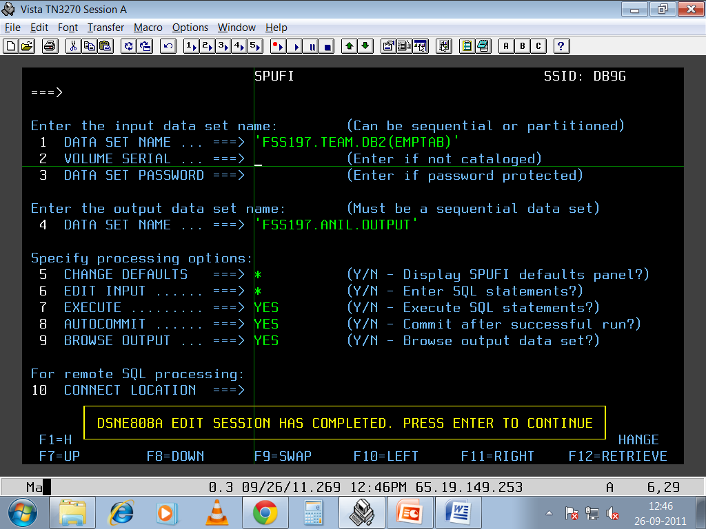

Slide 10
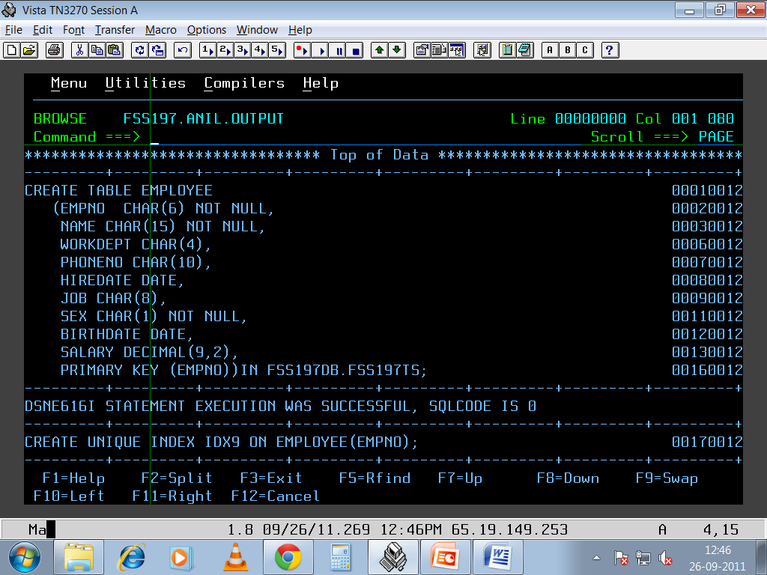

Slide 11
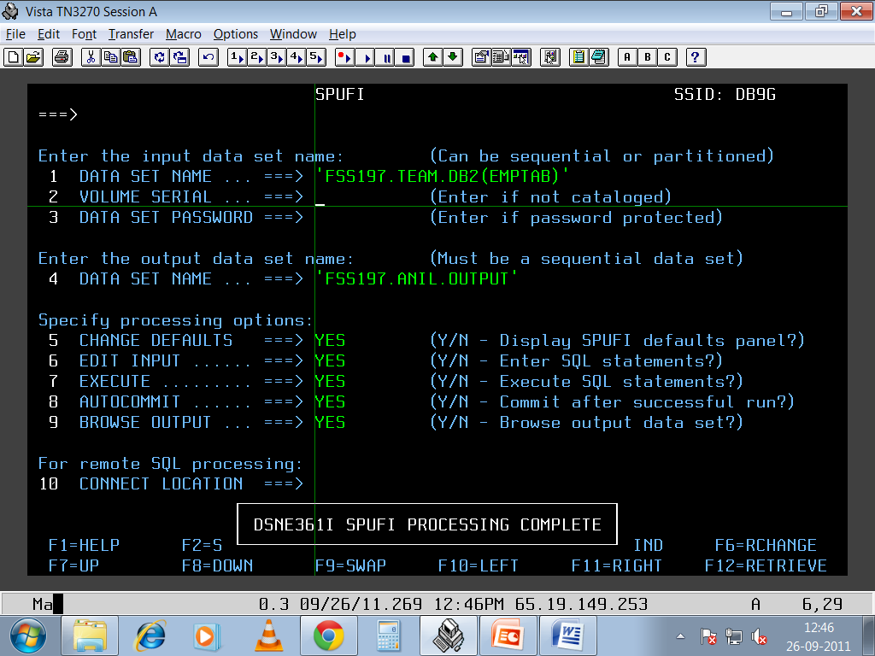

Slide 12
QMF
QUERY MANAGEMENT FACILITY

Slide 13
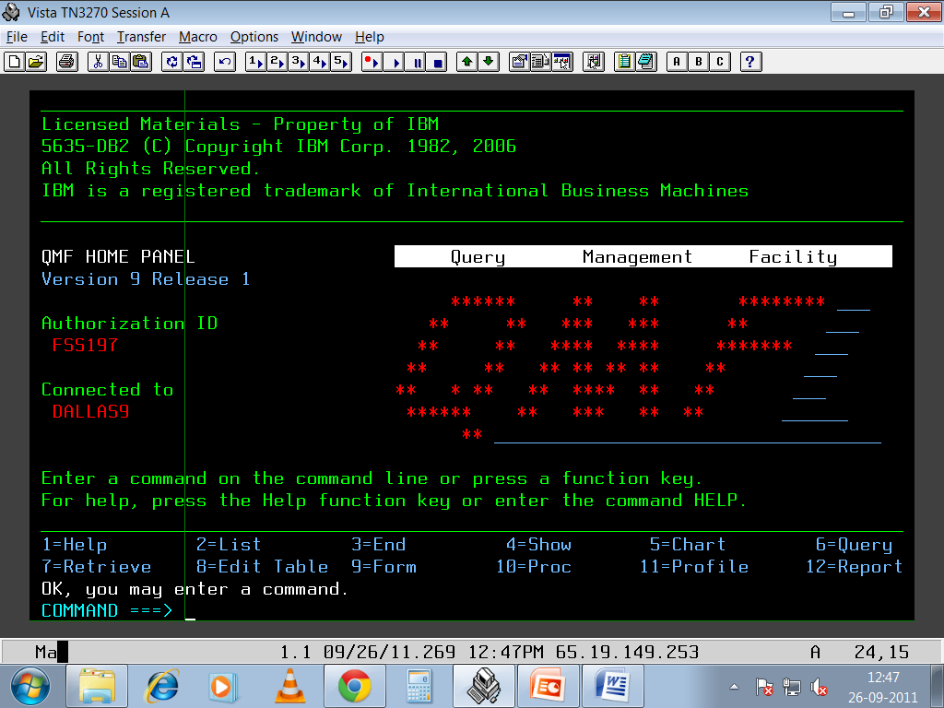

Slide 14
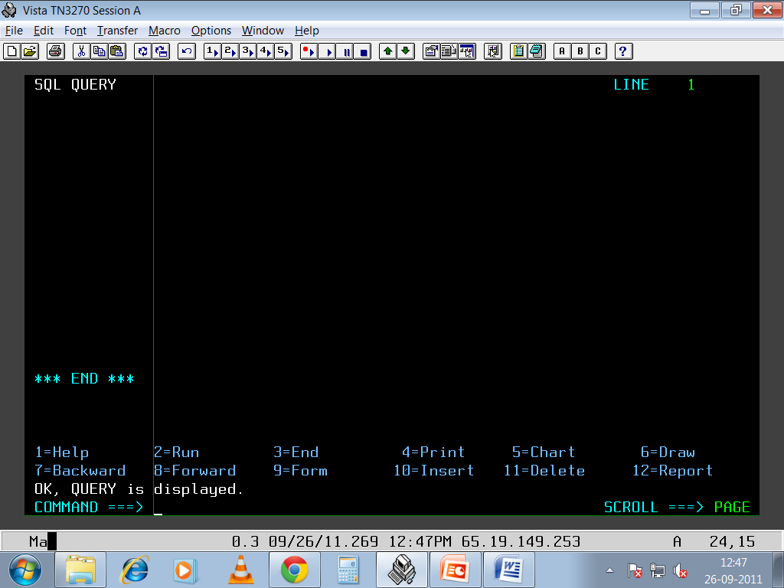

Slide 15
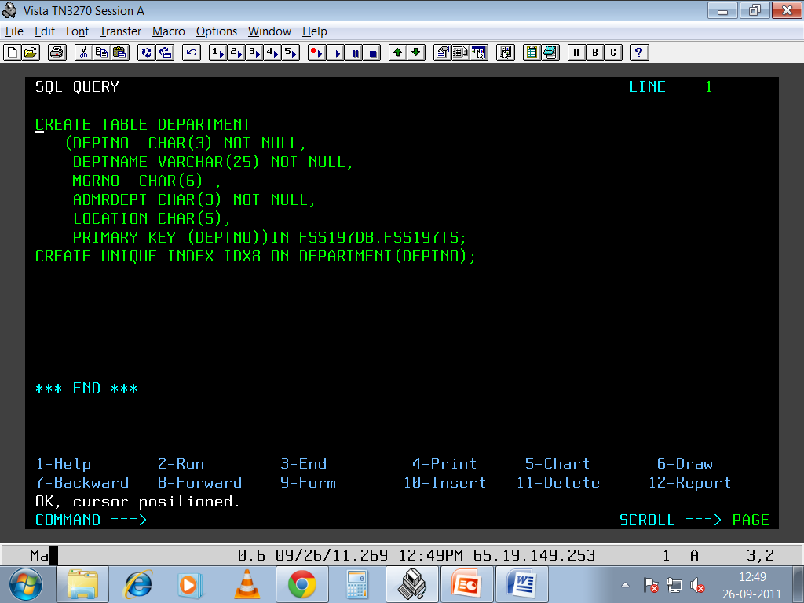

Slide 16
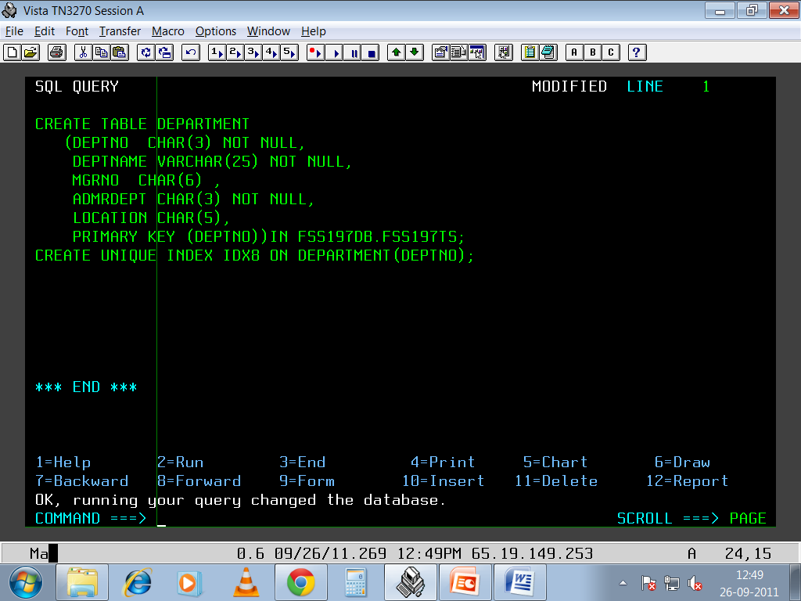

Slide 17
DCLGEN Tool

Slide 18
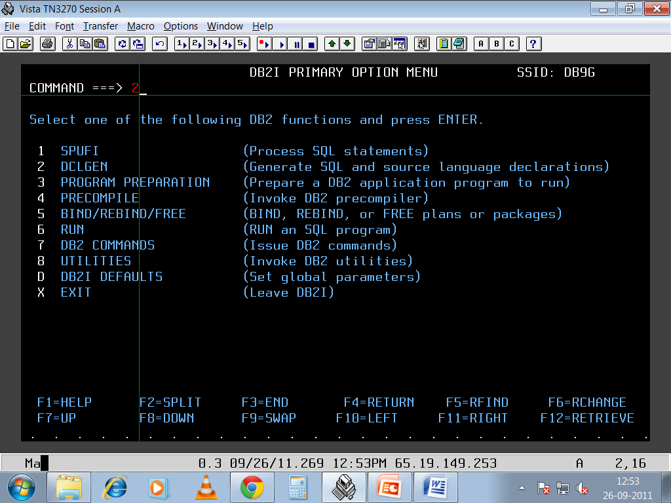

Slide 19
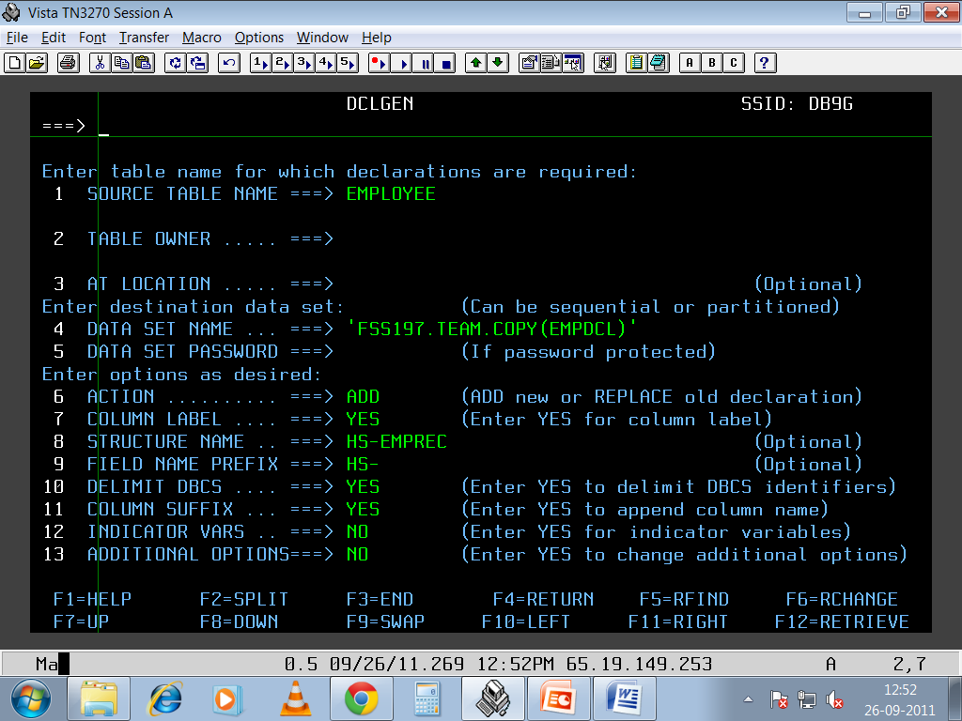

Slide 20
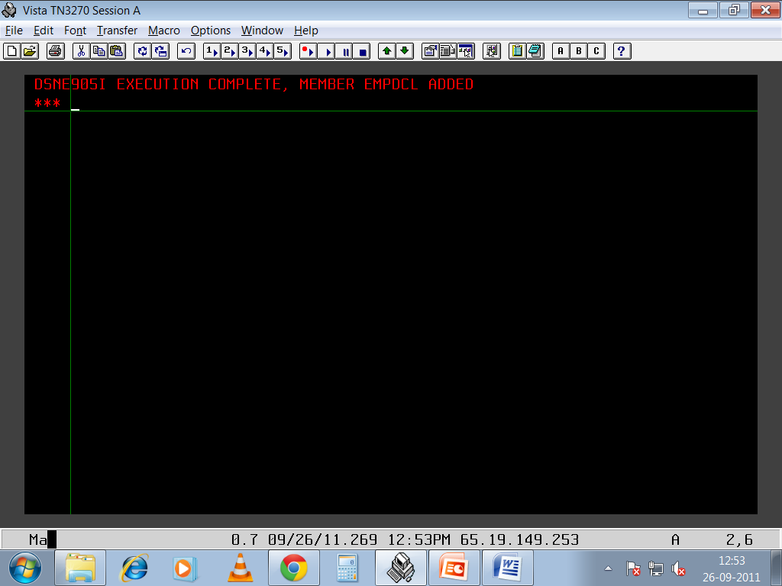

Slide 21
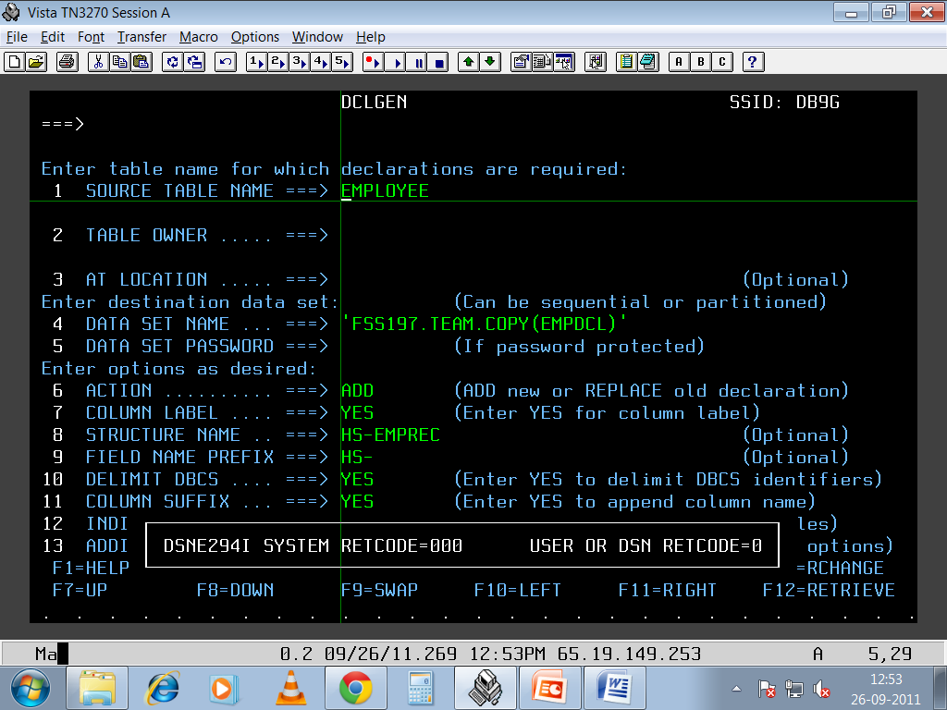

Slide 22
DB2 – COBOL DATATYPES
DB2 | COBOL
CHAR(n) | 10 FIELD-A PIC X(n)
VARCHAR(n) | 10 FIELD-A 49 FIELD-A-LENGTH PIC S9(4)COMP 49 FIELD-A-TEXT PIC X(n)
SMALLINT | 10 FIELD-A PIC S9(4) COMP
INTEGER | 10 FIELD-A PIC S9(9) COMP
DECIMAL(p , q ) | 10 FIELD-A PIC S9(p-q) V 9(q)COMP3
DATE-YYYY-MM-DD | 10 FIELD-A PIC X(10)
TIME - HH:MM:SS | 10 FIELD-A PIC X(8)
TIME STAMP | 10 FIELD-A PIC X(26)

Slide 23
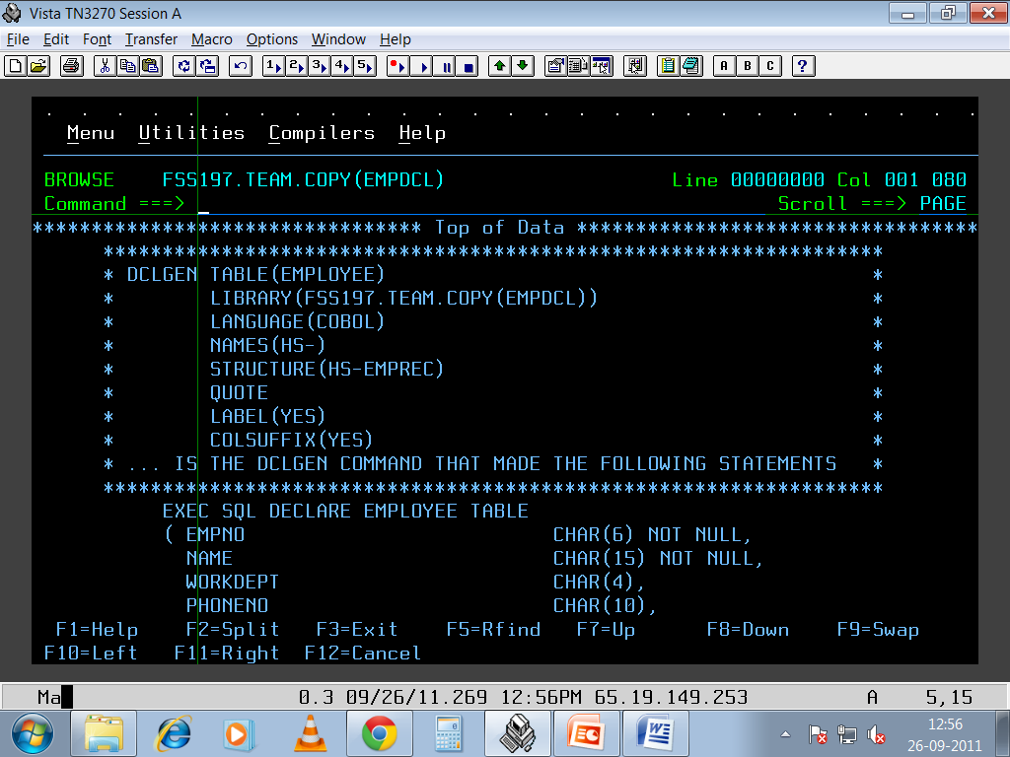

Slide 24
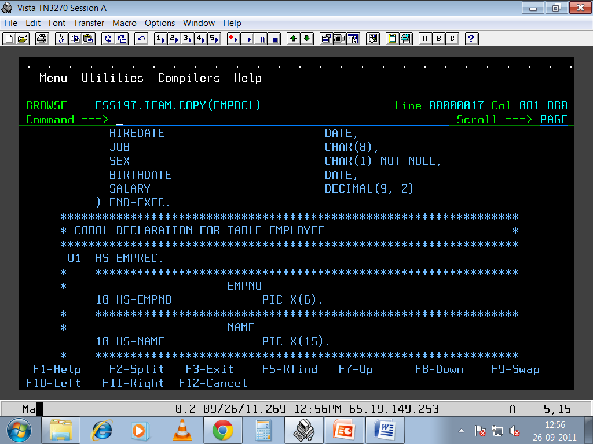

Slide 25
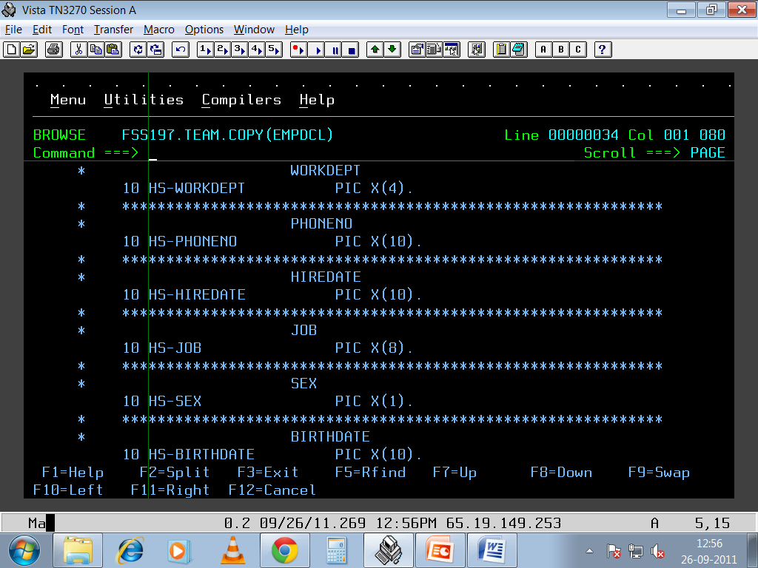

Slide 26
Thank You

